Slide 1

Youth Suicide Statistics:
2017 Thoughts, Behaviors, & Deaths
Stephen E. Brock, PhD, NCSP, LEP
California State University, Sacramento, CA, USA

Slide 2

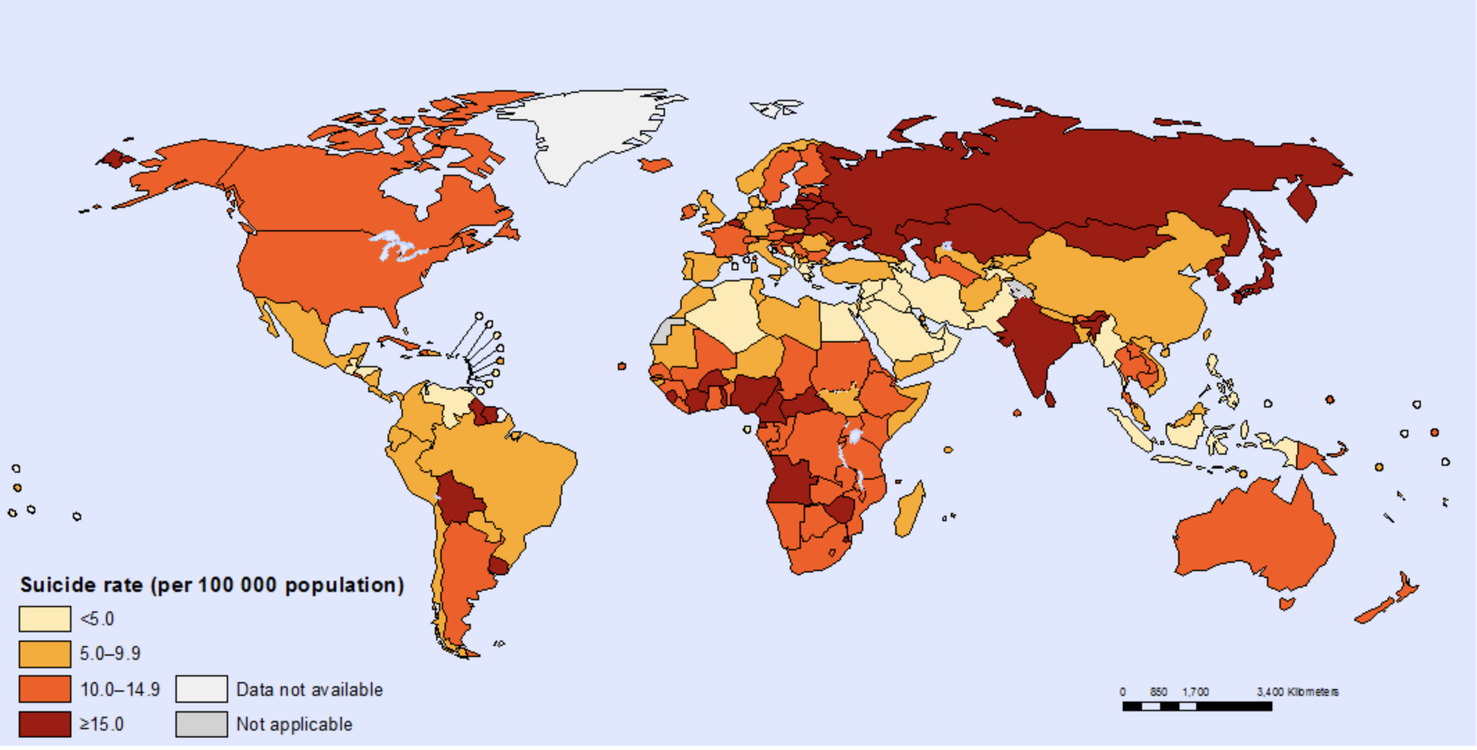

Statistics & Demographics
World Suicide Rates, 2015
(per 100,000 population)
World Health Organization (WHO, 2017)

Slide 3
Statistics & Demographics
World Suicide Rates, 2015
(per 100,000 population)
Rank | Country | Suicide Rate
1 | Sri Lanka | 34.6
2 | Guyana | 30.6
3 | Mongolia | 28.1
4 | Kazakhstan | 27.5
5 | CÃ’te d'Ivoire | 27.2
6 | Suriname | 26.9
7 | Equatorial Guinea | 26.6
8 | Lithuania | 26.1
9 | Angola | 25.9
10 | Republic of Korea | 24.1
WHO (2017)

Slide 4
Statistics & Demographics
World Suicide Rates, 2015
(per 100,000 population)
Rank | Country | Suicide Rate
48 | United States | 12.6
 | World Average | 10.5
175 | Sao Tome & Principe; Saint Vincent and the Grenadines | 02.6
177 | Pakistan | 02.5
178 | Bahamas | 01.6
179 | Brunei Darussalam | 01.4
179 | Jamaica | 01.4
181 | Grenada | 00.4
182 | Barbados | 00.3
183 | Antigua and Barbuda | 00.0
WHO (2017)

Slide 5
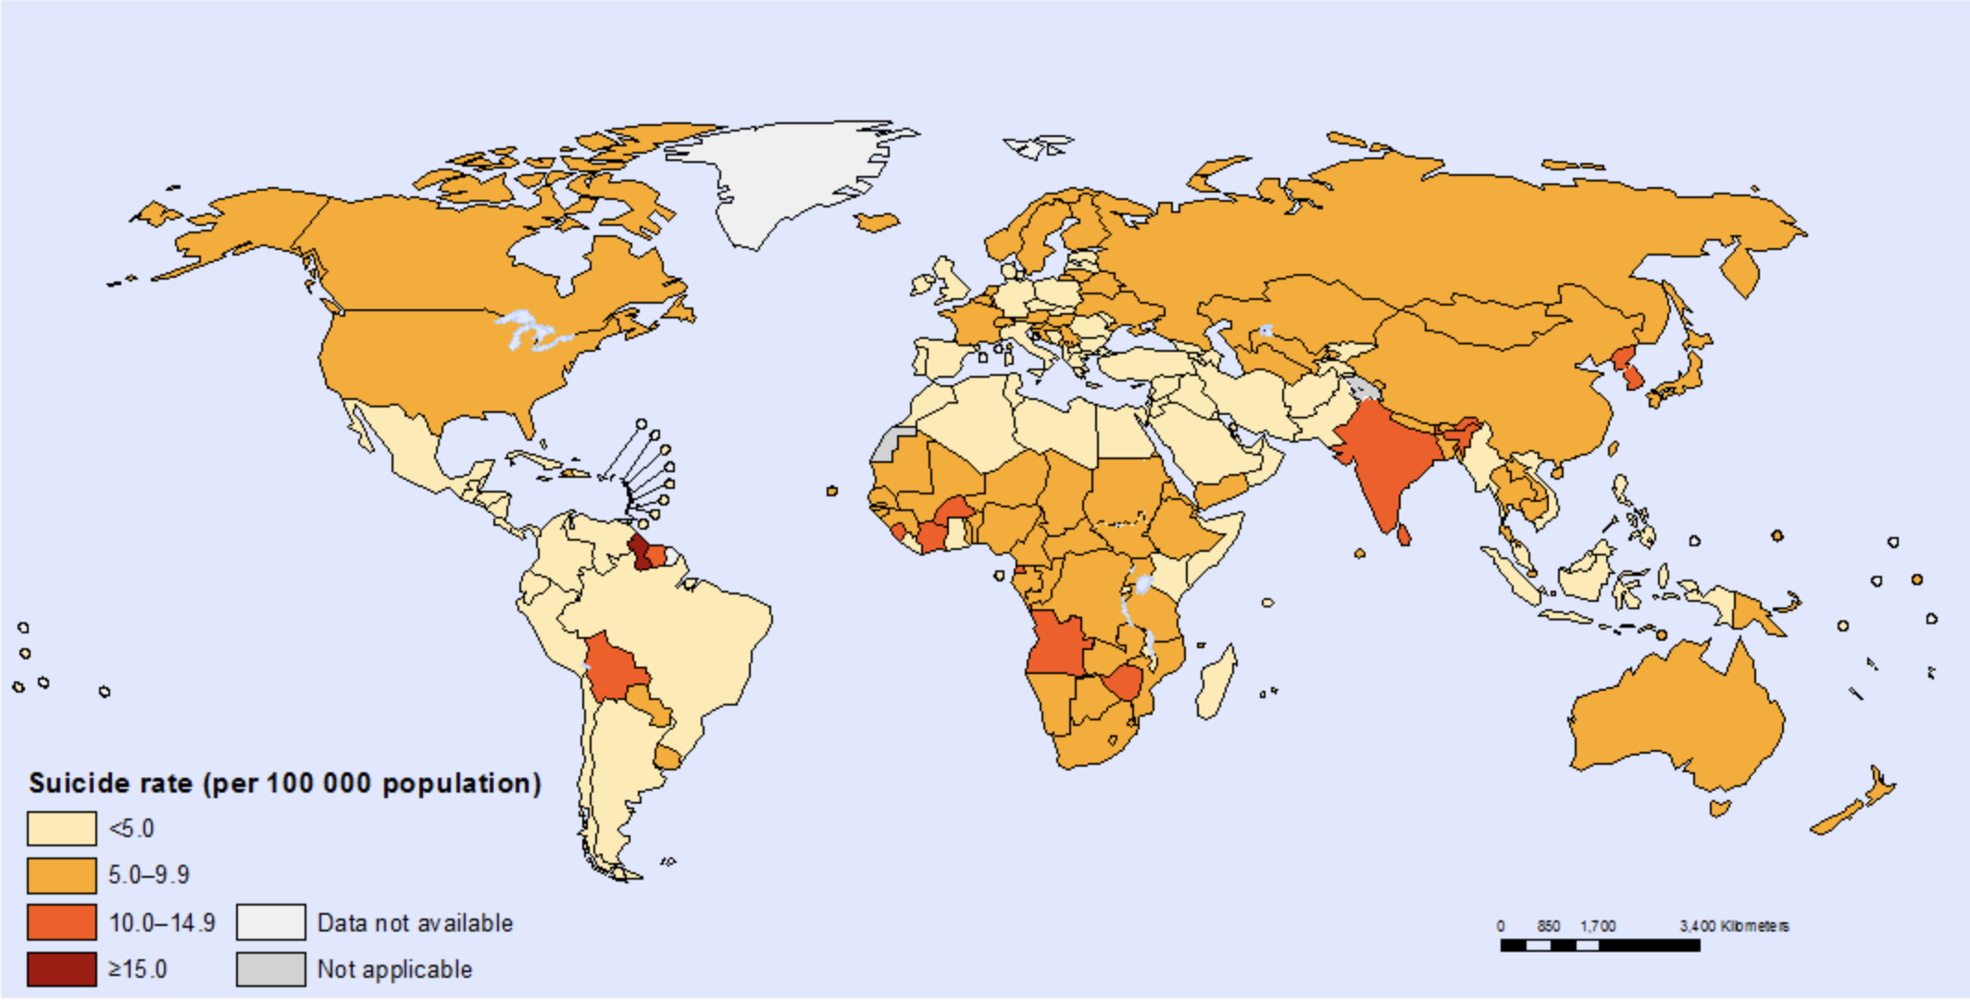
Statistics & Demographics
World Female Suicide Rates, 2015
WHO (2017)

Slide 6
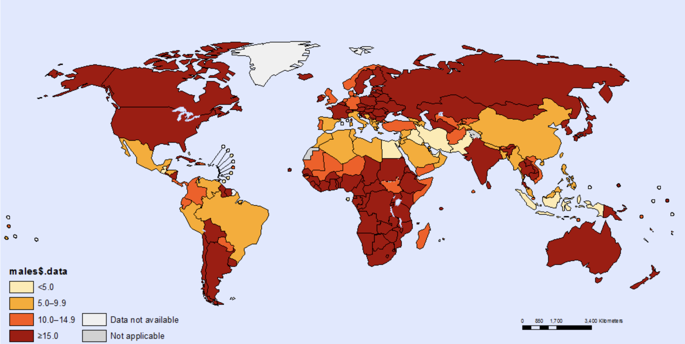
Statistics & Demographics
World Male Suicide Rates, 2015
WHO (2017)

Slide 7
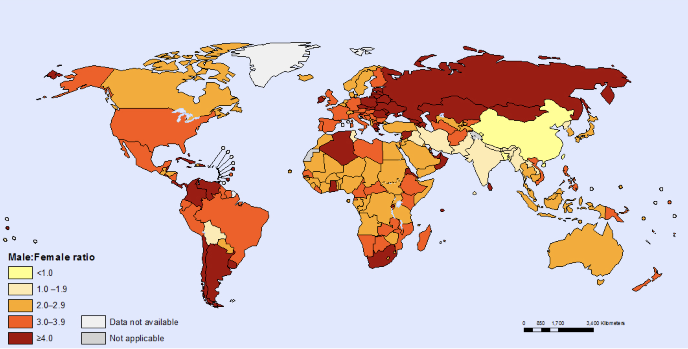
Statistics & Demographics
Male : Female Ratio of Suicide Deaths, 2015
The global Male:Female ratio of suicide deaths was 1.7 in 2015, meaning there was 1.7 male suicide deaths for each female suicide deaths
WHO (2017)

Slide 8
2017 Statistics & Demographics (2016)
Age in Years | # of Deaths¹ | Cause of Death Rank¹ | Suicide Rate²
5 to 8 | 0 | NA
9 | 4 (7) | 11 (9) | 0.10 (0.17)
10 | 12 (12) | 7 (8) | 0.29 (0.29)
11 | 24 (34) | 4 (3) | 1.01 (0.82)
12 | 77 (68) | 3 (3) | 1.86 (1.64)
13 | 149 (121) | 2 (2) | 3.59 (2.94)
14 | 237 (201) | 1 (2) | 5.74 (4.91)
15 | 349 (308) | 1 (2) | 8.48 (7.43)
16 | 438 (370) | 2 (2) | 10.37 (8.67)
17 | 469 (414) | 2 (2) | 10.92 (9.85)
18 | 559 (530) | 2 (2) | 13.18 (11.57)
Total | 2,337 (2,023) | 2 (2) | 4.03 (3.49)
¹CDC (2019); https://webappa.cdc.gov/sasweb/ncipc/leadcause.html
²CDC (2019); https://webappa.cdc.gov/sasweb/ncipc/mortrate.html

Slide 9
Youth Suicide Deaths by Age and Year
Statistics & Demographics
Year
CDC (2019); http://www.cdc.gov/injury/wisqars/

Slide 10
Statistics & Demographics
Magnitude of the problem
  Suicidal SDV among high school students in 2017¹
    17.2% seriously considered suicide
    13.6% made a suicide plan
    7.4% attempted suicide
    2.4% attempt required medical attention
  50 nonfatal self-harm injuries for each suicide death in 2017.²
    Females: 1 death for every 148 nonfatal self-harm injuries
    Males: 1 death for every 14.5 nonfatal self-harm injuries
¹Kann et al. (2018); ²CDC (2019)
Notes:
While, the death of a school aged person is actually an infrequent event, suicidal thinking and nonfatal suicide behaviors are remarkably common. From the most recent Youth Risk Behavior Survey (YRBS), Kann et al. (2018) report that among 9th to 12th graders, during the 12 months before taking the survey in 2017, 17.2% reported seriously considering attempting suicide; 13.6% reported that they had made a plan about how they would attempt suicide; 7.4% attempted suicide one or more times; and 2.4% made a suicide attempts that resulted in an injury, poisoning, or overdose that had to be treated by a doctor or nurse.

Slide 11
Statistics & Demographics (2017)
More males (5 to 18 years) die by suicide
  Gender ratio 3.625 male suicides (N = 1,725) for each female suicide (N = 612)
42% of 14-18 year old suicides is by a firearm.
  46% of 14-18 year old male suicides is by a firearm
  18% of 14-18 year old female suicides is by a firearm
  Suicide by firearms rate (all ages) = 7.32
  Suicide by firearms rate (14-18 yrs) = 4.31
  Suicide by firearms rate (14-18 yrs male) = 7.41
  Suicide by firearms rate (14-18 yrs female) = 1.07
Highest suicide rate is among American Indian/Alaskan Native men 25-29 (67.22 per 100,000¹)
CDC (2019); https://webappa.cdc.gov/sasweb/ncipc/mortrate.html

Slide 12
Statistics & Demographics
US Suicide Rates per 100,000 population, by County
2008-2014
CDC (2018); https://wisqars.cdc.gov:8443/cdcMapFramework/
Notes:
What trends do you see?
Do you see any patterns?
How might we explain these trends or patterns?
NOTE: These data reflect suicide deaths. The trends are somewhat different for other forms of suicidal behavior and thinking.

Slide 13
2017 Statistics & Demographics (2016)
Youth Suicide Deaths by State (15 to 24 year olds)
Rank | State | N | Rate
1 | Alaska (1) | 45 | 44.33
2 | Wyoming (11) | 27 | 36.31
3 | New Mexico (10) | 92 | 32.53
4 | Montana (2) | 43 | 31.58
5 | South Dakota (3) | 36 | 30.97
6 | North Dakota (8) | 31 | 27.61
7 | Utah (9) | 124 | 25.01
8 | Oklahoma (6) | 131 | 24.33
9 | Idaho (4) | 56 | 23.90
10 | New Hampshire (15) | 42 | 23.89
 | Total U.S. | 6,252 | 9.79
47 | California (44) | 522 | 9.60
CDC (2019)

Slide 14
Statistics & Demographics
California Suicide Rates per 100,000 population, by County 2008-2014
CDC (2018); https://wisqars.cdc.gov:8443/cdcMapFramework/

Slide 15
Statistics & Demographics
US Suicide Rate (& Undetermined Intent; 1981-2017)
Suicide Rate (per 100, 000)
CDC (2019): https://webappa.cdc.gov/cgi-bin/broker.exe
Notes:
http://www.cdc.gov/injury/wisqars/fatal_injury_reports.html
Economic crisis???
Current (2014) suicide rate = 13.41 (n = 42,773)
Current (2014) undetermined = 1.44 (n = 4,592)
Low (2000) = 10.43
High (2014) = 13.41

Slide 16
Statistics & Demographics
US Suicide Rates by Age & Gender (2007-2017)
Suicide Rate (per 100, 000)
CDC (2019); https://webappa.cdc.gov/sasweb/ncipc/mortrate.html
Notes:
Isolation aloneness
05-09 yrs,5 suicides in 2011, 4 males, 1 female in the entire country
10-14 yrs, 282suicide in 2011. Also very rare.
http://www.cdc.gov/injury/wisqars/fatal_injury_reports.html

Slide 17
Statistics & Demographics:
Male rates by age and ethnicity (2017)
CDC (2019)

Slide 18
Statistics & Demographics:
Male rates by age and ethnicity (2017)
CDC (2019)

Slide 19
Statistics & Demographics
Teen Suicide Rates:1981-2017 (15-19 years)
Suicide Rate (per 100,000)
CDC (2019)
Notes:
October 2004, FDA issues black box warning
http://virtualmentor.ama-assn.org/2012/06/pfor2-1206.html
http://journals.psychiatryonline.org/article.aspx?articleid=98898

Slide 20
Statistics & Demographics
Percent who Felt “sad or hopeless”
Percent
Kann et al. (2018)
Notes:
During the 12 months before the survey, 31.5% of students nationwide had felt so sad or hopeless almost every day for 2 or more weeks in a row that they stopped doing some usual activities.
Kann, L., McManus, T., Harris, W. A., Shanklin, S L., Flint, M. A., Queen, B., … Ethier, K. A. (2018, June). Youth Risk Behavior Surveillance — United States, 2017. MMWR Surveillance Summaries, 67(8), 1–114. doi: http://dx.doi.org/10.15585/mmwr.ss6708a1

Slide 21
Statistics & Demographics
Percent who “seriously considered attempting suicide”
Kann et al. (2018)
Notes:
Nationwide, 17.2 % of students had seriously considered attempting suicide during the 12 months before the survey.
Kann, L., McManus, T., Harris, W. A., Shanklin, S L., Flint, M. A., Queen, B., … Ethier, K. A. (2018, June). Youth Risk Behavior Surveillance — United States, 2017. MMWR Surveillance Summaries, 67(8), 1–114. doi: http://dx.doi.org/10.15585/mmwr.ss6708a1

Slide 22
Statistics & Demographics
Percent who “made a plan about how they would attempt suicide”
Percent
Kann et al. (2018)
Notes:
During the 12 months before the survey, 13.6% of students nationwide had made a plan about how they would attempt suicide.
Kann, L., McManus, T., Harris, W. A., Shanklin, S L., Flint, M. A., Queen, B., … Ethier, K. A. (2018, June). Youth Risk Behavior Surveillance — United States, 2017. MMWR Surveillance Summaries, 67(8), 1–114. doi: http://dx.doi.org/10.15585/mmwr.ss6708a1

Slide 23
Statistics & Demographics
Percent who “attempted suicide one or more times”
Percent
Kann et al. (2018)
Notes:
Nationwide, 7.4% of students had attempted suicide one or more times during the 12 months before the survey.
Kann, L., McManus, T., Harris, W. A., Shanklin, S L., Flint, M. A., Queen, B., … Ethier, K. A. (2018, June). Youth Risk Behavior Surveillance — United States, 2017. MMWR Surveillance Summaries, 67(8), 1–114. doi: http://dx.doi.org/10.15585/mmwr.ss6708a1

Slide 24
Statistics & Demographics
Percent who “made a suicide attempt that … had to be treated by a doctor or nurse”
Percent
Kann et al. (2018)
Notes:
During the 12 months before the survey, 2.4% of students nationwide had made a suicide attempt that resulted in an injury, poisoning, or overdose that had to be treated by a doctor or nurse
Kann, L., McManus, T., Harris, W. A., Shanklin, S L., Flint, M. A., Queen, B., … Ethier, K. A. (2018, June). Youth Risk Behavior Surveillance — United States, 2017. MMWR Surveillance Summaries, 67(8), 1–114. doi: http://dx.doi.org/10.15585/mmwr.ss6708a1

Slide 25
Statistics & Demographics
High School Students who Display Suicidal Behaviors
Percent
Kann et al. (2018)
Notes:
Kann, L., McManus, T., Harris, W. A., Shanklin, S L., Flint, M. A., Queen, B., … Ethier, K. A. (2018, June). Youth Risk Behavior Surveillance — United States, 2017. MMWR Surveillance Summaries, 67(8), 1–114. doi: http://dx.doi.org/10.15585/mmwr.ss6708a1

Slide 26
Youth Suicide Statistics:
2017 Thoughts, Behaviors, & Deaths
Stephen E. Brock, PhD, NCSP, LEP
California State University, Sacramento, CA, USA

